Slide 1
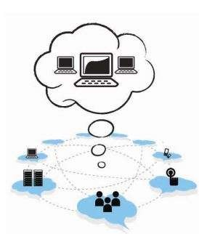
UNIT - 4

Slide 2
Cloud Service Models
Infrastructure as a Service
Characteristics of IaaS
Suitability of IaaS
Pros and Cons of IaaS
Summary of IaaS Providers
Platform as a Service
Characteristics of PaaS
Suitability of PaaS
Pros and Cons of PaaS
Summary of PaaS

Slide 3
Cloud Service Models
Providers, Software as a Service
Characteristics of SaaS
Suitability of SaaS
Pros and Cons of SaaS
Summary of SaaS Providers
Other Cloud Service Models

Slide 4
Introduction
Cloud computing is a model that enables the end users to access the shared pool of resources such as compute, network, storage, database, and application as an on-demand service without the need to buy or own it.
The services are provided and managed by the service provider, reducing the management effort from the end user side.
The essential characteristics of the cloud include on-demand self-service, broad network access, resource pooling, rapid elasticity, and measured service.
The National Institute of Standards and Technology (NIST) defines three basic service models, namely, IaaS, PaaS, and SaaS, as shown in Figure 5.1.

Slide 5
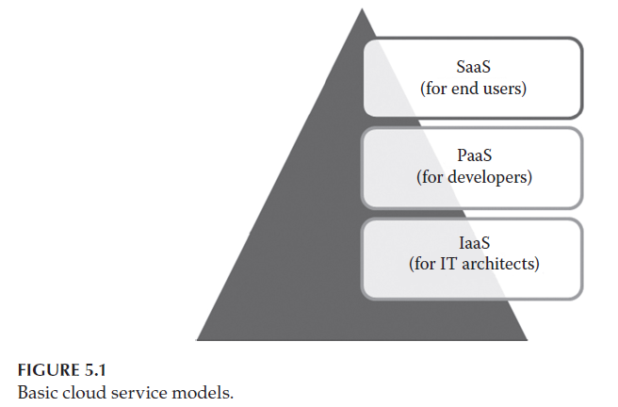
Introduction

Slide 6
Introduction
The NIST definition of the three basic service models is given as follows:
IaaS: The ability given to the infrastructure architects to deploy or run any software on the computing resources provided by the service provider.
Here, the underlying infrastructures such as compute, network, and storage are managed by the service provider.
Thus, the infrastructure architects are exempted from maintaining the data center or underlying infrastructure.
The end users are responsible for managing applications that are running on top of the service provider cloud infrastucture.

Slide 7
Introduction
Generally, the IaaS services are provided from the service provider cloud data center. The end users can access the services from their devices through web command line interface (CLI) or application programming interfaces (APIs) provided by the service providers.
Some of the popular IaaS providers include Amazon Web Services (AWS), Google Compute Engine, OpenStack, and Eucalyptus.

Slide 8
Introduction
2. PaaS: The ability given to developers to develop and deploy an application on the development platform provided by the service provider.
Thus, the developers are exempted from managing the development platform and underlying infrastructure. Here, the developers are responsible for managing the deployed application and configuring the development environment.
Generally, PaaS services are provided by the service provider on an on-premise or dedicated or hosted cloud infrastructure.
The developers can access the development platform over the Internet through web CLI, web user interface (UI), and integrated development environments (IDEs).
Some of the popular PaaS providers include Google App Engine, Force.com, Red Hat OpenShift, Heroku, and Engine Yard.

Slide 9
Introduction
3. SaaS: The ability given to the end users to access an application over the Internet that is hosted and managed by the service provider.
Thus, the end users are exempted from managing or controlling an application, the development platform, and the underlying infrastructure.
Generally, SaaS services are hosted in service provider–managed or service provider–hosted cloud infrastructure.
The end users can access the services from any thin clients or web browsers.
Some of the popular SaaS providers include Saleforce.com, Google Apps, and Microsoft office 365.

Slide 10
Introduction
The different cloud service models target different audiences.
For example, the IaaS model targets the information technology (IT) architects, PaaS targets the developers, and SaaS targets the end users.
Based on the services subscribed, the responsibility of the targeted audience may vary as shown in Figure 5.2.

Slide 11
Introduction
In IaaS, the end users are responsible for maintaining the development platform and the application running on top of the underlying infrastructure. The IaaS providers are responsible for maintaining the underlying hardware as shown in Figure 5.2a.
In PaaS, the end users are responsible for managing the application that they have developed. The underlying infrastructure will be maintained by the infrastructure provider as shown in Figure 5.2b.
In SaaS, the end user is free from maintaining the infrastructure, development platform, and application that they are using. All the maintenance will be carried out by the SaaS providers as shown Figure 5.2c.

Slide 12
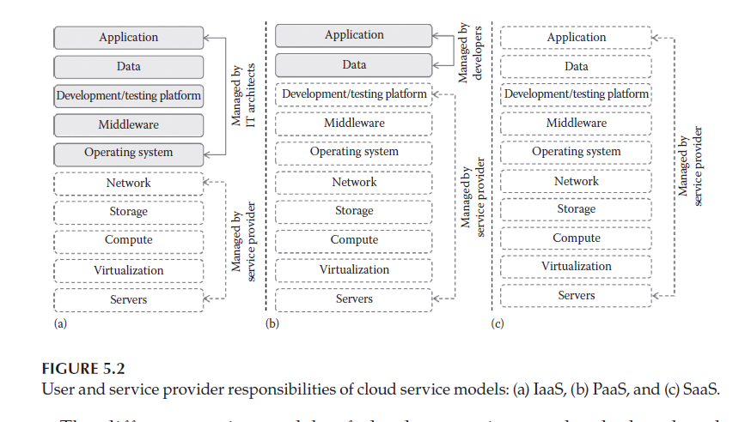
Introduction

Slide 13
Introduction
The different service models of cloud computing can be deployed and delivered through any one of the cloud deployment models.
The NIST defines four different types of cloud deployment models, namely, public cloud, private cloud, community cloud, and hybrid cloud.
The public cloud is provided for the general public. The private cloud is used by an organization for its multiple business units. The community cloud is for some group of organization with the same goals. The hybrid cloud is any combination of the public, private, and community clouds.
The service delivery of cloud services through different deployment models is shown in Figure 5.3.

Slide 14
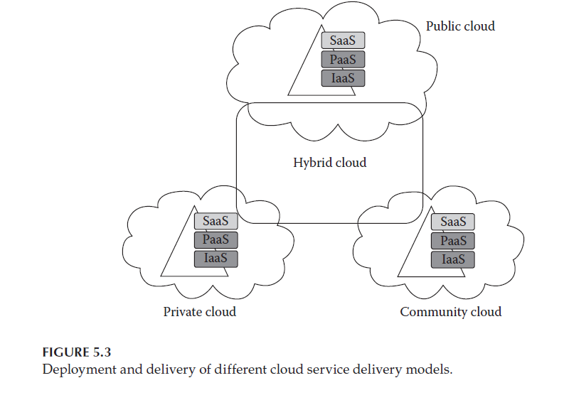
Introduction

Slide 15
Infrastructure as a Service
IaaS changes the way that the compute, storage, and networking resources are consumed. In traditional data centers, the computing power is consumed by having physical access to the infrastructure.
IaaS changes the computing from a physical infrastructure to a virtual infrastructure.
IaaS provides virtual computing, storage, and network resources by abstracting the physical resources. Technology virtualization is used to provide the virtual resources.
All the virtual resources are given to the virtual machines (VMs) that are configured by the service provider. The end users or IT architects will use the infrastructure resources in the form of VMs as shown in Figure 5.4.

Slide 16
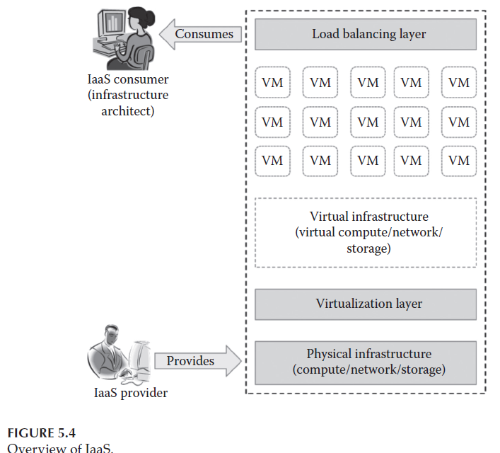
Infrastructure as a Service

Slide 17
Infrastructure as a Service
The targeted audience of IaaS is the IT architect.
The IT architect can design virtual infrastructure, network, load balancers, etc., based on their needs.
The IT architects need not maintain the physical servers as it is maintained by the service providers.
The physical infrastructure can be maintained by the service providers themselves. Thus, it eliminates or hides the complexity of maintaining the physical infrastructure from the IT architects.
A typical IaaS provider may provide the flowing services as shown in Figure 5.5:

Slide 18
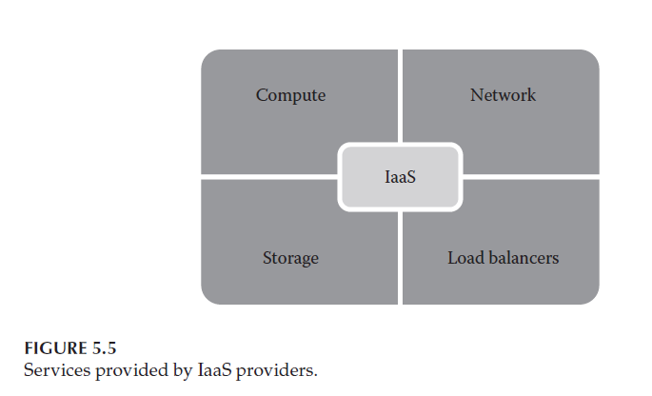
Infrastructure as a Service

Slide 19
Infrastructure as a Service
Compute: Computing as a Service includes virtual central processing units (CPUs) and virtual main memory for the VMs that are provisioned to the end users.
2. Storage: STaaS provides back-end storage for the VM images. Some of the IaaS providers also provide the back end for storing files.
3. Network: Network as a Service (NaaS) provides virtual networking components such as virtual router, switch, and bridge for the VMs
.
4. Load balancers: Load Balancing as a Service may provide load balancing capability at the infrastructure layer.

Slide 20
Characteristics of IaaS
IaaS providers offer virtual computing resources to the consumers on a pay-as-you-go basis.
IaaS contains the characteristics of cloud computing such as on-demand self-service, broad network access, resource pooling, rapid elasticity, and measured service.
Apart from all these, IaaS has its own unique characteristics as follows:

Slide 21
Characteristics of IaaS
Web access to the resources: The IaaS model enables the IT users to access infrastructure resources over the Internet. When accessing a huge computing power, the IT user need not get physical access to the servers. Through any web browsers or management console, the users can access the required infrastructure.
Centralized management: Even though the physical resources are distributed, the management will be from a single place. The resources distributed across different parts can be controlled from any management console. This ensures effective resource management and effective resource utilization.

Slide 22
Characteristics of IaaS
3. Elasticity and dynamic scaling: IaaS provides elastic services where the usage of resources can be increased or decreased according to the requirements. The infrastructure need depends on the load on the application.
According to the load, IaaS services can provide the resources. The load on any application is dynamic and IaaS services are capable of proving the required services dynamically.
4. Shared infrastructure: IaaS follows a one-to-many delivery model and allows multiple IT users to share the same physical infrastructure. The different IT users will be given different VMs. IaaS ensures high resource utilization.

Slide 23
Characteristics of IaaS
5. Preconfigured VMs: IaaS providers offer preconfigured VMs with operating systems (OSs), network configuration, etc.
The IT users can select any kind of VMs of their choice. The IT users are free to configure VMs from scratch. The users can directly start using the VMs as soon as they subscribed to the services.
6. Metered services: IaaS allows the IT users to rent the computing resources instead of buying it.
The services consumed by the IT user will be measured, and the users will be charged by the IaaS providers based on the amount of usage.

Slide 24
Suitability of IaaS
IaaS reduces the total cost of ownership (TCO) and increases the return on investment (ROI) for start-up companies that cannot invest more in buying infrastructure.
IaaS can be used in the following situations:
Unpredictable spikes in usage
Limited capital investment
Infrastructure on demand

Slide 25
Suitability of IaaS
Unpredictable spikes in usage: When there is a significant spike in usage of computing resources, IaaS is the best option for IT industries.
When demand is very volatile, we cannot predict the spikes and troughs in terms of demand of the infrastructure.
In this situation, we cannot add or remove infrastructure immediately according to the demand in a traditional infrastructure.
If there is an unpredictable demand of infrastructure, then it is recommended to use IaaS services.

Slide 26
Suitability of IaaS
Limited capital investment: New start-up companies cannot invest more on buying infrastructure for their business needs.
And so by using IaaS, start-up companies can reduce the capital investment on hardware.
IaaS is the suitable option for start-up companies with less capital investment on hardware.
Infrastructure on demand: Some organizations may require large infrastructure for a short period of time.
For this purpose, an organization cannot afford to buy more on-premise resources. Instead, they can rent the required infrastructure for a specific period of time.
IaaS best suits the organizations that look for infrastructure on demand or for a short time period.

Slide 27
Suitability of IaaS
IaaS helps start-up companies limit its capital expenditure. While it is widely used by start-up companies, there are some situations where IaaS may not be the best option. In following situations, IT users should avoid using the IaaS.
When regulatory compliance does not allow off-premise hosting: For some companies, its regulation may not allow the application and data to be hosted on third-party off-premise infrastructure.
2. When usage is minimal: When the usage is minimal and the available on-premise infrastructure itself is capable of satisfying their needs.

Slide 28
Suitability of IaaS
3. When better performance is required: Since the IaaS services are accessed through the Internet, sometimes the performance might be not as expected due to network latency.
4. When there is a need for more control on physical infrastructure: Some organizations might require physical control over the underlying infrastructure. As the IaaS services are abstracted as virtual resources, it is not possible to have more control on underlying physical infrastructure.

Slide 29
Pros and Cons of IaaS
Being one of the important service models of cloud computing, IaaS provides lot of benefits to the IT users. The following are the benefits provided by IaaS:
Pay-as-you-use model: The IaaS services are provided to the customers on a pay-per-use basis. This ensures that the customers are required to pay for what they have used. This model eliminates the unnecessary spending on buying. hardware
.
2. Reduced TCO: Since IaaS providers allow the IT users to rent the computing resources, they need not buy physical hardware for running their business. The IT users can rent the IT infrastructure rather than buy it by spending large amount. IaaS reduces the need for buying hardware resources and thus reduces the TCO.

Slide 30
Pros and Cons of IaaS
3.Elastic resources: IaaS provides resources based on the current needs. IT users can scale up or scale down the resources whenever they want.
This dynamic scaling is done automatically using some load balancers.
This load balancer transfers the additional resource request to the new server and improves application efficiency.
4. Better resource utilization: Resource utilization is the most important criteria to succeed in the IT business.
The purchased infrastructure should be utilized properly to increase the ROI. IaaS ensures better resource utilization and provides high ROI for IaaS providers.

Slide 31
Pros and Cons of IaaS
5. Supports Green IT: In traditional IT infrastructure, dedicated servers are used for different business needs. Since many servers are used, the power consumption will be high. This does not result in Green IT.
In IaaS, the need of buying dedicated servers is eliminated as single infrastructure is shared between multiple customers, thus reducing the number of servers to be purchased and hence the power consumption that results in Green IT.

Slide 32
Pros and Cons of IaaS
Even though IaaS provides cost-related benefits to small-scale industries, it lacks in providing security to the data. The following are the drawbacks of IaaS:
Security issues: Since IaaS uses virtualization as the enabling technology, hypervisors play an important role. There are many attacks that target the hypervisors to compromise it. If hypervisors get compromised, then any VMs can be attacked easily. Most of the IaaS providers are not able to provide 100% security to the VMs and the data stored on the VMs.
2. Interoperability issues: There are no common standards followed among the different IaaS providers. It is very difficult to migrate any VM from one IaaS provider to the other. Sometimes, the customers might face the vendor lock-in problem.

Slide 33
Pros and Cons of IaaS
3. Performance issues: IaaS is nothing but the consolidation of available resources from the distributed cloud servers.
Here, all the distributed servers are connected over the network.
Latency of the network plays an important role in deciding the performance.
Because of latency issues, sometimes the VM contains issues with its performance.

Slide 34
Summary of IaaS Providers
There are many public and private IaaS providers in the market who provides infrastructure services to the end users.
Table 5.1 provides the summary of popular infrastructure providers.
In the table, the popular IaaS providers are classified based on the license, deployment model, and supported host OS, guest OS, and hypervisors.
The end user may choose any IaaS provider that matches their needs.

Slide 35
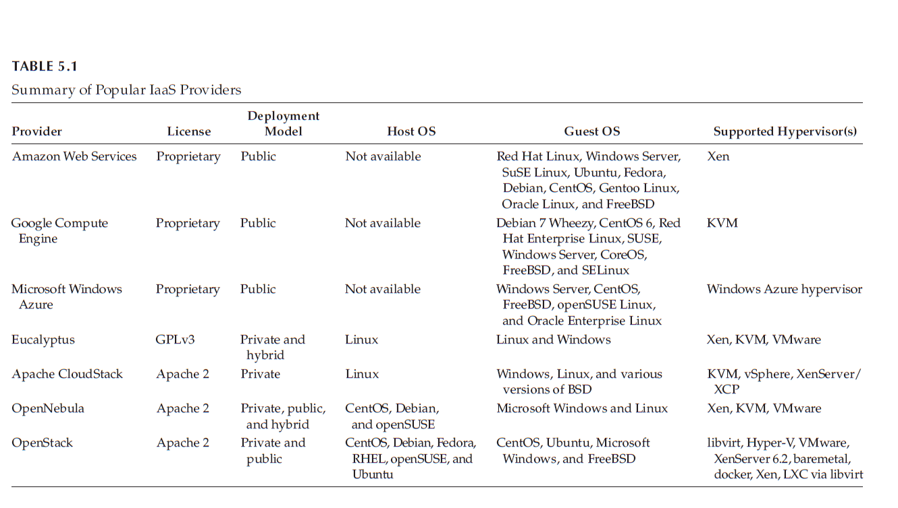
Summary of IaaS Providers

Slide 36
Summary of IaaS Providers
Generally, public IaaS consumers need not consider the host OS as it is maintained by the service provider.
In managing the private cloud, the users should see the supported host OS.
However, most of the private IaaS supports popular guest OS, fully depending on the hypervisor that the IaaS providers are supporting.

Slide 37
Platform as a Service
PaaS changes the way that the software is developed and deployed. In traditional application development, the application will be developed locally and will be hosted in the central location.
In stand-alone application development, the applications will be developed and delivered as executables.
Most of the applications developed by traditional development platforms result in a licensing-based software, whereas PaaS changes the application development from local machine to online.
PaaS providers provide the development PaaS from the data center. The developers can consume the services over the Internet as shown in Figure 5.6.

Slide 38
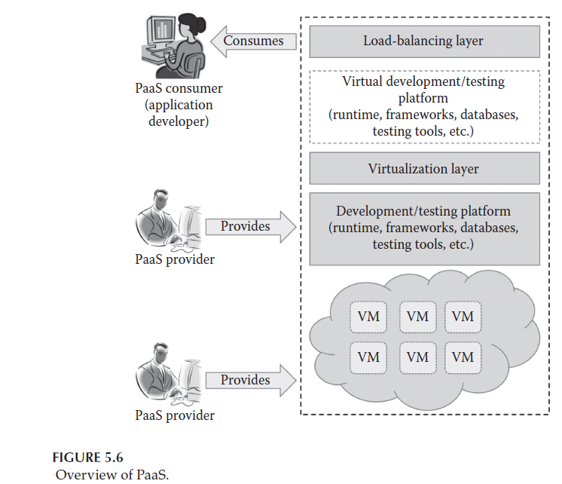
Platform as a Service

Slide 39
Platform as a Service
PaaS allows the developers to develop their application online and also allows them to deploy immediately on the same platform.
PaaS consumers or developers can consume language runtimes, application frameworks, databases, message queues, testing tools, and deployment tools as a service over the Internet.
Thus, it reduces the complexity of buying and maintaining different tools for developing an application.
Typical PaaS providers may provide programming languages, application frameworks, databases, and testing tools as shown in Figure 5.7.
Some of the PaaS providers also provide build tools, deployment tools, and software load balancers as a service:

Slide 40
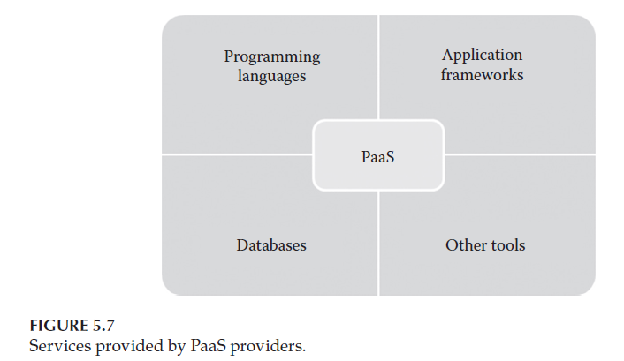
Platform as a Service

Slide 41
Platform as a Service
Programming languages: PaaS providers provide a wide variety of programming languages for the developers to develop applications. Some of the popular programming languages provided by PaaS vendors are Java, Perl, PHP, Python, Ruby, Scala, Clojure, and Go.
2. Application frameworks: PaaS vendors provide application frameworks that simplify the application development. Some of the popular application development frameworks provided by a PaaS provider include Node.js, Rails, Drupal, Joomla, WordPress, Django, EE6, Spring, Play, Sinatra, Rack, and Zend.
.

Slide 42
Platform as a Service
3. Database: Since every application needs to communicate with the databases, it becomes a must-have tool for every application. PaaS providers are providing databases also with their PaaS platforms. The popular databases provided by the popular PaaS vendors are ClearDB, PostgreSQL, Cloudant, Membase, MongoDB, and Redis.
4. Other tools: PaaS providers provide all the tools that are required to develop, test, and deploy an application.

Slide 43
Characteristics of PaaS
PaaS development platforms are different from the traditional application development platforms. The following are the essential characteristics that make PaaS unique from traditional development platforms:
All in one: Most of the PaaS providers offer services to develop, test, deploy, host, and maintain applications in the same IDE.
Additionally, many service providers provide all the programming languages, frameworks, databases, and other development-related services that make developers choose from a wide variety of development platforms.

Slide 44
Characteristics of PaaS
2. Web access to the development platform: A typical development platform uses any IDEs for developing applications.
Typically, the IDE will be installed in the developer’s machines. But, PaaS provides web access to the development platform. Using web UI, any developer can get access to the development platform.
The web-based UI helps the developers create, modify, test, and deploy different applications on the same platform.

Slide 45
Characteristics of PaaS
3. Offline access: A developer may not be able to connect to the Internet for a whole day to access the PaaS services. When there is no Internet connectivity, the developers should be allowed to work offline. To enable offline development, some of the PaaS providers allow the developer to synchronize their local IDE with the PaaS services. The developers can develop an application locally and deploy it online whenever they are connected to the Internet.
4. Built-in scalability: Scalability is an important requirement for the new-generation web or SaaS applications. It is very difficult to enable the dynamic scalability for any application developed using traditional development platforms. But, PaaS services provide built-in scalability to an application that is developed using any particular PaaS. This ensures that the application is capable of handling varying loads efficiently.

Slide 46
Characteristics of PaaS
5. Collaborative platform: Nowadays, the development team consists of developers who are working from different places. There is a need for a common platform where the developers can collaboratively work together on the same project. Most of the PaaS services provide support for collaborative development. To enable collaboration among developers, most of the PaaS providers provide tools for project planning and communication.
6. Diverse client tools: To make the development easier, PaaS providers provide a wide variety of client tools to help the developer. The client tools include CLI, web CLI, web UI, REST API, and IDE. The developers can choose any tools of their choice. These client tools are also capable of handling billing and subscription management.

Slide 47
Suitability of PaaS
Most of the start-up SaaS development companies and independent software vendors (ISVs) widely use PaaS in developing an application. PaaS technology is getting attention from other traditional software development companies also. PaaS is a suitable option for the following situations:
Collaborative development: To increase the time to market and development efficiency, there is a need for a common place where the development team and other stakeholders of the application can collaborate with each other.
Since PaaS services provide a collaborative development environment, it is a suitable option for applications that need collaboration among developers and other third parties to carry out the development process.

Slide 48
Suitability of PaaS
2. Automated testing and deployment: Automated testing and building of an application are very useful while developing applications at a very short time frame. The automated testing tools reduce the time spent in manual testing tools.
Most of the PaaS services offer automated testing and deployment capabilities. The development team needs to concentrate more on development rather than testing and deployment.
Thus, PaaS services are the best option where there is a need for automated testing and deployment of the applications.

Slide 49
Suitability of PaaS
3. Time to market: The PaaS services follow the iterative and incremental development methodologies that ensure that the application is in the market as per the time frame given.
For example, the PaaS services are the best option for application development that uses agile development methodologies.
If the software vendor wants their application to be in the market as soon as possible, then the PaaS services are the best option for the development.

Slide 50
Suitability of PaaS
PaaS is used widely to accelerate the application development process to ensure the time to market. Most of the start-up companies and ISVs started migrating to the PaaS services. Even though it is used widely, there are some situations where PaaS may not be the best option:
Frequent application migration: The major problem with PaaS services are vendor lock-in. Since there are no common standards followed among PaaS providers, it is very difficult to migrate the application from one PaaS provider to the other.

Slide 51
Suitability of PaaS
2. Customization at the infrastructure level: PaaS is an abstracted service, and the PaaS users do not have full control over the underlying infrastructure.
There are some application development platforms that need some configuration or customization of underlying infrastructure.
In these situations, it is not possible to customize the underlying infrastructure with PaaS. If the application development platform needs any configuration at the hardware level, it is not recommended to go for PaaS.
3. Flexibility at the platform level: PaaS provides template-based applications where all the different programming languages, databases, and message queues are predefined. It is an advantage if the application is a generic application.

Slide 52
Suitability of PaaS
4. Integration with on-premise application: A company might have used PaaS services for some set of applications. For some set of applications, they might have used on-premise platforms.
Since many PaaS services use their own proprietary technologies to define the application stack, it may not match with the on-premise application stack.
This makes the integration of application hosted in on-premise platform and PaaS platform a difficult job.

Slide 53
Pros and Cons of PaaS
The main advantage of using PaaS is that it hides the complexity of maintaining the platform and underlying infrastructure.
This allows the developers to work more on implementing the important functionalities of the application. Apart from this, the PaaS has the following benefits:
Quick development and deployment: PaaS provides all the required development and testing tools to develop, test, and deploy the software in one place.
Most of the PaaS services automate the testing and deployment process as soon as the developer completes the development. This speeds up application development and deployment than traditional development platforms.

Slide 54
Pros and Cons of PaaS
2. Reduces TCO: The developers need not buy licensed development and testing tools if PaaS services are selected.
Most of the traditional development platforms requires high-end infrastructure for its working, which increases the TCO of the application development company. But, PaaS allows the developers to rent the software, development platforms, and testing tools to develop, build, and deploy the application.
PaaS does not require high-end infrastructure also to develop the application, thus reducing the TCO of the development company.

Slide 55
Pros and Cons of PaaS
3. Supports agile software development: Nowadays, most of the new-generation applications are developed using agile methodologies.
Many ISVs and SaaS development companies started adopting agile methodologies for application development.
PaaS services support agile methodologies that the ISVs and other development companies are looking for.
4. Different teams can work together: The traditional development platform does not have extensive support for collaborative development. PaaS services support developers from different places to work together on the same project. This is possible because of the online common development platform provided by PaaS providers.

Slide 56
Pros and Cons of PaaS
5. Ease of use: The traditional development platform uses any one of CLI- or IDE-based interfaces for development.
Some developers may not be familiar with the interfaces provided by the application development platform.
This makes the development job a little bit difficult. But, PaaS provides a wide variety of client tools such as CLI, web CLI, web UI, APIs, and IDEs.
The developers are free to choose any client tools of their choice. Especially, the web UI–based PaaS services increase the usability of the development platform for all types of developers.

Slide 57
Pros and Cons of PaaS
6. Less maintenance overhead: In on-premise applications, the development company or software vendor is responsible for maintaining the underlying hardware. They need to recruit skilled administrators to maintain the servers. This overhead is eliminated by the PaaS services as the underlying infrastructure is maintained by the infrastructure providers. This gives freedom to developers to work on the application development.
7. Produces scalable applications: Most of the applications developed using PaaS services are web application or SaaS application. These applications require better scalability on the extra load. For handling extra load, the software vendors need to maintain an additional server. It is very difficult for a new start-up company to provide extra servers based on the additional load. But, PaaS services are providing built-in scalability to the application that is developed using the PaaS platform.

Slide 58
Pros and Cons of PaaS
PaaS provides a lot of benefits to developers when compared to the traditional development environment. On the other hand, it contains drawbacks, which are described in the following:
Vendor lock-in: The major drawback with PaaS providers are vendor lock-in. The main reason for vendor lock-in is lack of standards.
There are no common standards followed among the different PaaS providers. The other reason for vendor lock-in is proprietary technologies used by PaaS providers.
Most of the PaaS vendors use the proprietary technologies that are not compatible with the other PaaS providers.
The vendor lock-in problem of PaaS services does not allow the applications to be migrated from one PaaS provider to the other.
2. Security issues: Like in the other cloud services, security is one of the major issues in PaaS services. Since data are stored in off-premise third-party servers, many developers are afraid to go for PaaS

Slide 59
Pros and Cons of PaaS
2. Security issues: Like in the other cloud services, security is one of the major issues in PaaS services. Since data are stored in off-premise third-party servers, many developers are afraid to go for PaaS services.
Of course, many PaaS providers provide mechanisms to protect the user data, and it is not sufficient to feel the safety of on-premise deployment.
When selecting the PaaS provider, the developer should review the regulatory, compliance, and security policies of the PaaS provider with their own security requirements.
If not properly reviewed, the developers or users are at the risk of data security breach.

Slide 60
Pros and Cons of PaaS
3. Less flexibility: PaaS providers do not give much freedom for the developers to define their own application stack.
Most of the PaaS providers provide many programming languages, databases, and other development tools. But, it is not extensive and does not satisfy all developer needs.
Only some of the PaaS providers allow developers to extend the PaaS tools with the custom or new programming languages.
Still most of the PaaS providers do not provide flexibility to the developers.

Slide 61
Pros and Cons of PaaS
4. Depends on Internet connection: Since the PaaS services are delivered over the Internet, the developers should depend on Internet connectivity for developing the application.
Even though some of the providers allow offline access, most of the PaaS providers do not allow offline access.
With slow Internet connection, the usability and efficiency of the PaaS platform do not satisfy the developer requirements.

Slide 62
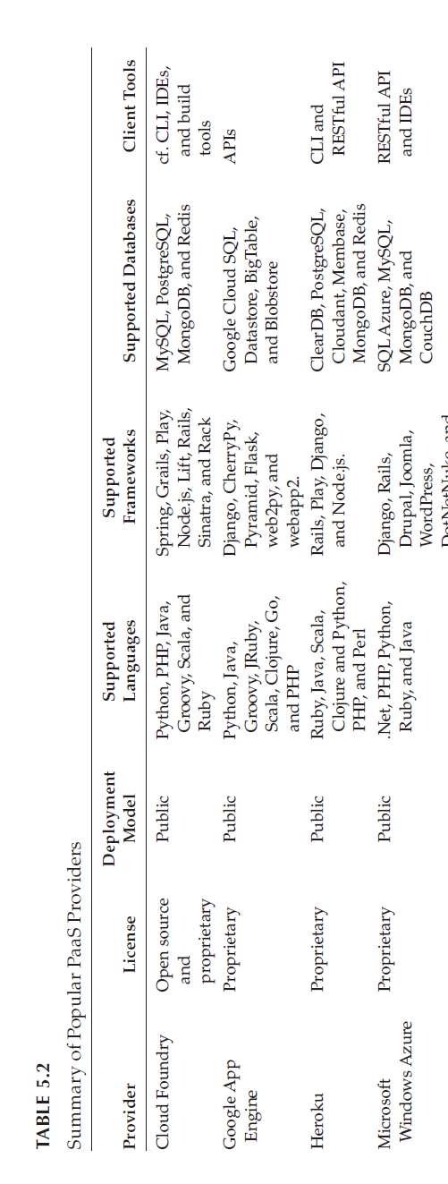
Summary of PaaS Providers
PaaS providers are more in the IT market for public as well as the private clouds. Table 5.2 gives a summary of popular private and public PaaS providers.

Slide 63
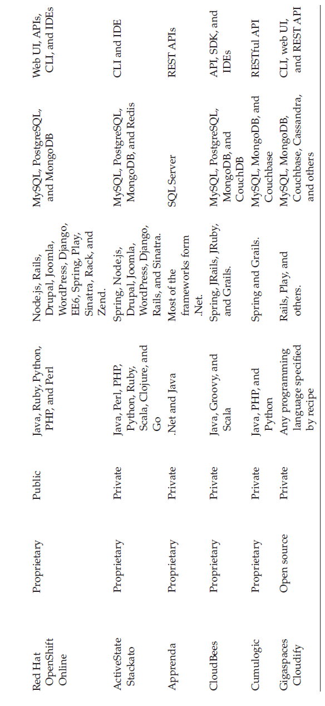
Summary of PaaS Providers

Slide 64
Software as a Service (SaaS)
Software as a Service SaaS changes the way the software is delivered to the customers.
In the traditional software model, the software is delivered as a license-based product that needs to be installed in the end user device.
Since SaaS is delivered as an on-demand service over the Internet, there is no need to install the software to the end user’s devices.
SaaS services can be accessed or disconnected at any time based on the end user’s needs.

Slide 65
(SaaS)
SaaS services can be accessed from any lightweight web browsers on any devices such as laptops, tablets, and smartphones.
Some of the SaaS services can be accessed from a thin client that does not contain much storage space and cannot run much software like the traditional desktop PCs.
The important benefits of using thin clients for accessing the SaaS application are as follows: it is less vulnerable to attack, has a longer life cycle, consumes less power, and is less expensive.

Slide 66
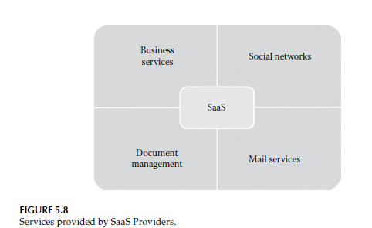
Software as a Service

Slide 67
Software as a Service
Business services: Most of the SaaS providers started providing a variety of business services that attract start-up companies. The business SaaS services include ERP, CRM, billing, sales, and human resources.
2. Social networks: Since social networking sites are extensively used by the general public, many social networking service providers adopted SaaS for their sustainability. Since the number of users of the social networking sites is increasing exponentially, cloud computing is the perfect match for handling the variable load.

Slide 68
Software as a Service
3. Document management: Since most of the enterprises extensively use electronic documents, most of the SaaS providers started providing services that are used to create, manage, and track electronic documents.
4. Mail services: E-mail services are currently used by many people. The future growth in e-mail usage is unpredictable. To handle the unpredictable number of users and the load on e-mail services, most of the e-mail providers started offering their services as SaaS services.

Slide 69
Characteristics of SaaS
SaaS services are different and give more benefits to end users than the traditional software.
The following are the essential characteristics of SaaS services that make it unique from traditional software:
One to many
Web access
Centralized management
Multidevice support
Better scalability
High availability
API integration

Slide 70
Characteristics of SaaS
One to many: SaaS services are delivered as a one-to-many model where a single instance of the application can be shared by multiple tenants or customers.
Web access: SaaS services provide web access to the software. It allows the end user to access the application from any location if the device is connected to the Internet.
3. Centralized management: Since SaaS services are hosted and managed from the central location, management of the SaaS application becomes easier. Normally, the SaaS providers will perform the automatic updates that ensure that each tenant is accessing the most recent version of the application without any user-side updates.

Slide 71
Characteristics of SaaS
4. Multidevice support: SaaS services can be accessed from any end user devices such as desktops, laptops, tablets, smartphones, and thin clients.
5. Better scalability: Since most of the SaaS services leverage PaaS and IaaS for its development and deployment, it ensures a better scalability than the traditional software. The dynamic scaling of underlying cloud resources makes SaaS applications work efficiently even with varying loads.
6. High availability: SaaS services ensure the 99.99% availability of user data as proper backup and recovery mechanisms are implemented at the back end.
7. API integration: SaaS services have the capability of integrating with other software or service through standard APIs.

Slide 72
Suitability of SaaS
SaaS is popular among individuals and start-up companies because of the benefits it provides. Most of the traditional software users are looking for SaaS versions of the software as SaaS has several advantages over traditional applications.
SaaS applications are the best option for the following:
1. On-demand software: The licensing-based software model requires buying full packaged software and increases the spending on buying software. Some of the occasionally used software does not give any ROI. Because of this, many end users are looking for a software that they can use as and when they needed. If the end users are looking for on-demand software rather than the licensing-based full-term software, then the SaaS model is the best option.

Slide 73
Suitability of SaaS
2. Software for start-up companies: When using any traditional software, the end user should buy devices with minimum requirements specified by the software vendor. This increases the investment on buying hardware for start-up companies. Since SaaS services do not require high-end infrastructure for accessing, it is a suitable option for start-up companies that can reduce the initial expenditure on buying high-end hardware.
3. Software compatible with multiple devices: Some of the applications like word processors or mail services need better accessibility from different devices. The SaaS applications are adaptable with almost all the devices.

Slide 74
Suitability of SaaS
4. Software with varying loads: We cannot predict the load on popular applications such as social networking sites. The user may connect or disconnect from applications anytime. It is very difficult to handle varying loads with the traditional infrastructure. With the dynamic scaling capabilities, SaaS applications can handle varying loads efficiently without disrupting the normal behavior of the application.

Slide 75
Suitability of SaaS
Most of the traditional software vendors moved to SaaS business as it is an emerging software delivery model that attracts end users.
But still many traditional applications do not have its SaaS versions. This implies that SaaS applications may not be the best option for all types of software.
The SaaS delivery model is not the best option for the applications mentioned in the following:
1. Real-time applications: Since SaaS applications depend on Internet connectivity, it may not work better with low Internet speed. If data are stored far away from the end user, the latency issues may delay the data retrieval timings. Real-time applications require fast processing of data that may not be possible with the SaaS applications because of the dependency on high-speed Internet connectivity and latency issues.

Slide 76
Suitability of SaaS
2. Applications with confidential data: Data security, data governance, and data compliance are always issues with SaaS applications. Since data are stored with third-party service providers, there is no surety that our data will be safe. If the stored confidential data get lost, it will make a serious loss to the organization. It is not recommended to go for SaaS for applications that handle confidential data.
3. Better on-premise application: Some of the on-premise applications might fulfill all the requirements of the organization. In such situations, migrating to the SaaS model may not be the best option.

Slide 77
Pros and Cons of SaaS
SaaS applications are used by a wide range of individuals and start-up industries for its cost-related benefits. Apart from the cost-related benefits, SaaS services provide the following benefits:
No client-side installation: SaaS services do not require client-side installation of the software. The end users can access the services directly from the service provider data center without any installation. There is no need of high-end hardware to consume SaaS services. It can be accessed from thin clients or any handheld devices, thus reducing the initial expenditure on buying high-end hardware.
Cost savings: Since SaaS services follow the utility-based billing or pay-as-you-go billing, it demands the end users to pay for what they have used. Most of the SaaS providers offer different subscription plans to benefit different customers. Sometimes, the generic SaaS services such as word processors are given for free to the end users.

Slide 78
Pros and Cons of SaaS
3. Less maintenance: SaaS services eliminate the additional overhead of maintaining the software from the client side. For example, in the traditional software, the end user is responsible for performing bulk updates. But in SaaS, the service provider itself maintains the automatic updates, monitoring, and other maintenance activities of the applications.
4. Ease of access: SaaS services can be accessed from any devices if it is connected to the Internet. Accessibility of SaaS services is not restricted to any particular devices. It is adaptable to all the devices as it uses the responsive web UI.
5. Dynamic scaling: SaaS services are popularly known for elastic dynamic scaling. It is very difficult for on-premise software to provide dynamic scaling capability as it requires additional hardware. Since the SaaS services leverage elastic resources provided by cloud computing, it can handle any type of varying loads without disrupting the normal behavior of the application.

Slide 79
Pros and Cons of SaaS
6. Disaster recovery: With proper backup and recovery mechanisms, replicas are maintained for every SaaS services. The replicas are distributed across many servers. If any server fails, the end user can access the SaaS from other servers. It eliminates the problem of single point of failure. It also ensures the high availability of the application.
7. Multitenancy: Multitenancy is the ability given to the end users to share a single instance of the application. Multitenancy increases resource utilization from the service provider side.

Slide 80
Pros and Cons of SaaS
Even though SaaS services are used by many individuals and start-up industries, the adoption from the large industries is very low. The major problem with SaaS services is security to the data. All companies are worried about the security of their data that are hosted in the service provider data center. The following are the major problems with SaaS services:
1. Security: Security is the major concern in migrating to SaaS application. Since the SaaS application is shared between many end users, there is a possibility of data leakage. Here, the data are stored in the service provider data center. We cannot simply trust some third-party service provider to store our company-sensitive and confidential data. The end user should be careful while selecting the SaaS provider to avoid unnecessary data loss.

Slide 81
Pros and Cons of SaaS
2. Connectivity requirements: SaaS applications require Internet connectivity for accessing it. Sometimes, the end user’s Internet connectivity might be very slow. In such situations, the user cannot access the services with ease. The dependency on high-speed Internet connection is a major problem in SaaS applications.
3. Loss of control: Since the data are stored in a third-party and off-premise location, the end user does not have any control over the data. The degree of control over the SaaS application and data is lesser than the on-premise application.

Slide 82
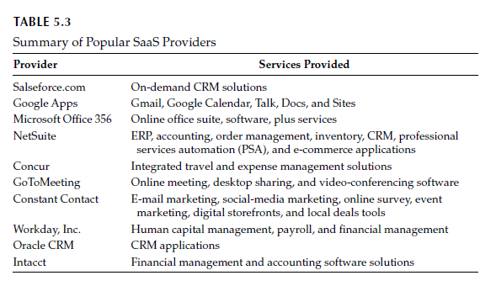
Summary of SaaS Providers
There are many SaaS providers who provide SaaS services such as ERP, CRM, billing, document management, and mail services. Table 5.3 gives a summary of popular SaaS vendors in the market.

Slide 83
Other Cloud Service Models
The basic cloud services such as IaaS, PaaS, and SaaS are widely used by many individual and start-up companies.
Now, cloud computing becomes the dominant technology that drives the IT world. Because of the extensive use of basic cloud services, the end users realize the importance and benefits of specific services such as network, storage, and database.
The basic cloud service models are the unified models that contain multiple services in it.
Now, the end users’ expectation changed, and they are expecting the individual services to be offered by service providers.

Slide 84
Other Cloud Service Models
This makes most of the service providers to think about the separate services that meet end user requirements. Many service providers already started offering separate services such as network, desktop, database, and storage on demand as given in the following:
1. NaaS: is an ability given to the end users to access virtual network services that are provided by the service provider. Like other cloud service models, NaaS is also a business model for delivering virtual network services over the Internet on a pay-per-use basis. In on-premise data center, the IT industries spent a lot of money to buy network hardware to manage in-house networks. But, cloud computing changes networking services into a utility-based service.

Slide 85
Other Cloud Service Models
NaaS allows network architects to create virtual networks, virtual network interface cards (NICs), virtual routers, virtual switches, and other networking components.
Additionally, it allows the network architect to deploy custom routing protocols and enables the design of efficient in-network services, such as data aggregation, stream processing, and caching.
Some of the popular services provided by NaaS include virtual private network (VPN), bandwidth on demand (BoD), and mobile network virtualization.

Slide 86
Other Cloud Service Models
2. Desktop as a Service (DEaaS) is an ability given to the end users to use desktop virtualization without buying and managing their own infrastructure. DEaaS is a pay-per-use cloud service delivery model in which the service provider manages the back-end responsibilities of data storage, backup, security, and upgrades.
The end users are responsible for managing their own desktop images, applications, and security. Accessing the virtual desktop provided by the DEaaS provider is device, location, and network independent. DEaaS services are simple to deploy, are highly secure, and produce better experience on almost all devices.

Slide 87
Other Cloud Service Models
3. STaaS is an ability given to the end users to store the data on the storage services provided by the service provider. STaaS allows the end users to access the files at any time from any place.
The STaaS provider provides the virtual storage that is abstracted from the physical storage of any cloud data center.
STaaS is also a cloud business model that is delivered as a utility. Here, the customers can rent the storage from the STaaS provider. STaaS is commonly used as a backup storage for efficient disaster recovery.

Slide 88
Other Cloud Service Models
4. DBaaS is an ability given to the end users to access the database service without the need to install and maintain it.
The service provider is responsible for installing and maintaining the databases. The end users can directly access the services and can pay according to their usage.
DBaaS automates the database administration process. The end users can access the database services through any API or web UIs provided by the service provider.
The DBaaS eases the database administration process. Popular examples of DBaaS include SimpleDB, DynamoDB, MongoDB as a Service, GAE datastore, and ScaleDB.

Slide 89
Other Cloud Service Models
5. Data as a Service (DaaS) is an ability given to the end users to access the data that are provided by the service provider over the Internet.
DaaS provides data on demand. The data may include text, images, sounds, and videos.
DaaS is closely related to other cloud service models such as SaaS and STaaS.
DaaS can be easily integrated with SaaS or STaaS for providing the composite service.
DaaS is highly used in geography data services and financial data services. The advantages of DaaS include agility, cost effectiveness, and data quality.

Slide 90
Other Cloud Service Models
6. SECaaS is an ability given to the end user to access the security service provided by the service provider on a pay-per-use basis.
In SECaaS, the service provider integrates their security services to benefit the end users. Generally, the SECaaS includes authentication, antivirus, antimalware/spyware, intrusion detection, and security event management.
The security services provided by the SECaaS providers are typically used for securing the on-premise or in-house infrastructure and applications.
Some of the SECaaS providers include Cisco, McAfee, Panda Software, Symantec, Trend Micro, and VeriSign.

Slide 91
Other Cloud Service Models
IDaaS is an ability given to the end users to access the authentication infrastructure that is managed and provided by the third-party service provider.
The end user of IDaaS is typically an organization or enterprise. Using IDaaS services, any organization can easily manage their employees’ identity without any additional overhead.
Generally, IDaaS includes directory services, federated services, registration, authentication services, risk and event monitoring, single sign-on services, and identity and profile management.

Slide 92
The different new service models discussed in this section emerged after the introduction of cloud computing.
This field still evolves and introduces new service models based on the end user’s needs.
Many researchers from industry and academia already started introducing their innovative idea to take cloud computing to the next level.
Apart from the service models discussed in this chapter, cloud computing researchers are thinking to add more service models.
Now, cloud computing moves to the scenario where everything can be given as a service. This can be termed as Everything as a Service (XaaS).

Slide 93
In the future, we expect many new service models to achieve the goal of XaaS.
XaaS may include Backup as a Service (BaaS), Communication as a Service (CaaS), Hadoop as a Service (HaaS), Disaster Recovery as a Service (DRaaS), Testing as a Service (TaaS), Firewall as a Service (FWaaS), Virtual Private Network as a Service (VPNaaS), Load Balancers as a Service (LBaaS), Message Queue as a Service (MQaaS), and Monitoring as a Service (MaaS).

Slide 94
Thank you

